Slide 1
Digital Portfolio
STUDENT NAME: Vanitha K
REGISTER NO AND NMID: 24131211802522084 and asanm121anm12124214085
DEPARTMENT: BSc. Computer Science
COLLEGE/UNIVERSITY: Immaculate college for women/Annamalai University

Slide 2
PROJECT TITLE
Student Portfolio developed with HTML, CSS

Slide 3


AGENDA
Problem Statement
Project Overview
End Users
Tools and Technologies
Portfolio design and Layout
Features and Functionality
Results and Screenshots
Conclusion
Github Link
3/21/2024 Annual Review

Slide 4

PROBLEM STATEMENT
Traditional resumes and paper-based portfolios are static and often fail to effectively represent a student’s creativity, projects, and dynamic progress.
Hence, there is a need for a Student Portfolio.

Slide 5

PROJECT OVERVIEW
This project involves the development of a responsive student portfolio website using HTML, CSS, and JavaScript. The portfolio highlights personal details, academic qualifications and skills in a professional manner. The objective is to create a platform that is visually appealing, easy to navigate, and adaptable across devices.

Slide 6

WHO ARE THE END USERS?
• Students – to showcase their academic and technical profile • Recruiters – to evaluate student skills, achievements, and projects • Faculty – to assess student progress and provide academic references • General Audience – to gain an overview of the student’s background and expertise

Slide 7

TOOLS AND TECHNIQUES
• HTML – for content structure. • CSS – for styling and layout. • JavaScript – for interactivity and dynamic features. • Visual Studio Code – as the development environment. • Git and GitHub – for version control and deployment

Slide 8
PORTFOLIO DESIGN AND LAYOUT
The portfolio follows a clean, minimalistic design to ensure clarity and professionalism.
It includes a homepage with personal introduction, sections for academic details, skills, project highlights, and a contact page.
A responsive layout ensures accessibility on desktop and mobile devices, maintaining consistent design aesthetics.
It involves two way design by maintaining multi-tab page in desktop and scrollable page in small and medium devices.

Slide 9
FEATURES AND FUNCTIONALITY
• Interactive navigation bar for smooth browsing in large screen devices. • Responsive design compatible with multiple devices. • Dedicated sections for About Me, Skills, and achievements • Contact box for easy communication with links. • Integration with GitHub to showcase project repositories. • User-friendly interface with clear typography and layout
9

Slide 10
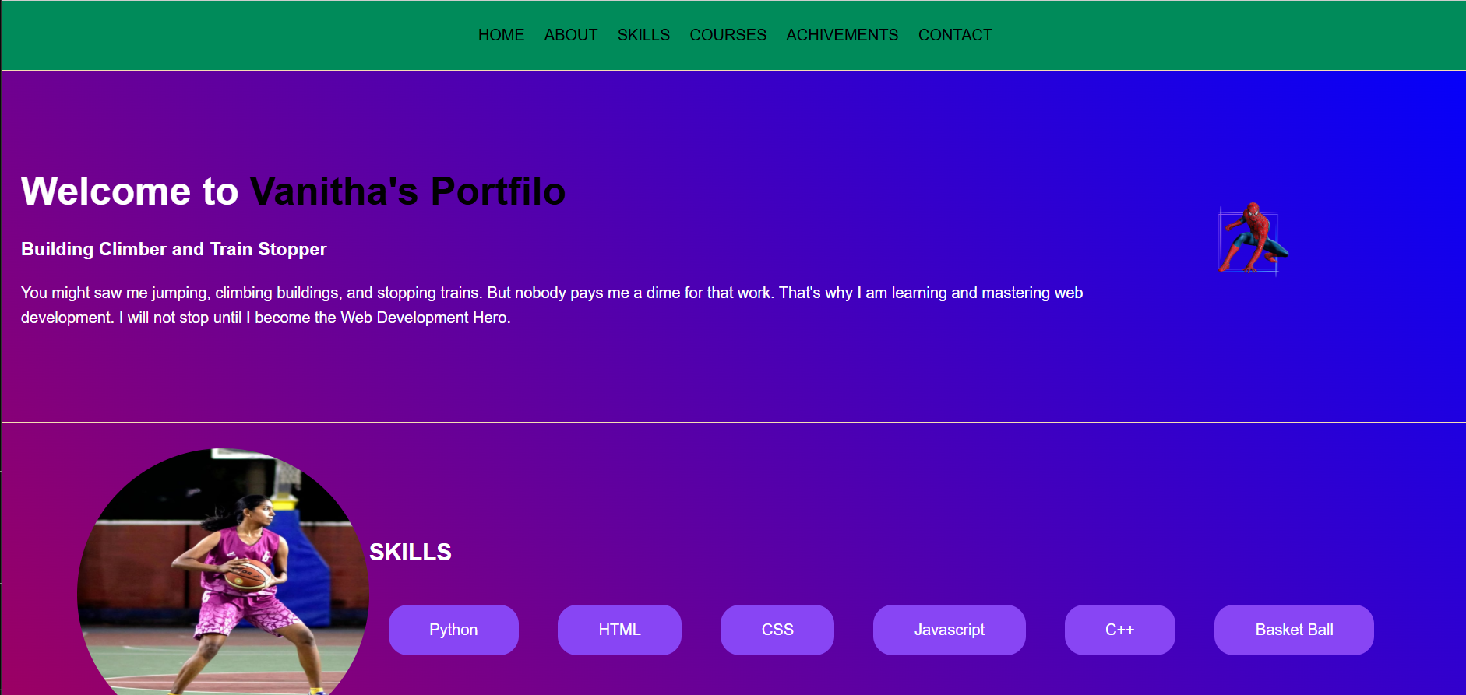

RESULTS AND SCREENSHOTS
3/21/2024 Annual Review
10

Slide 11
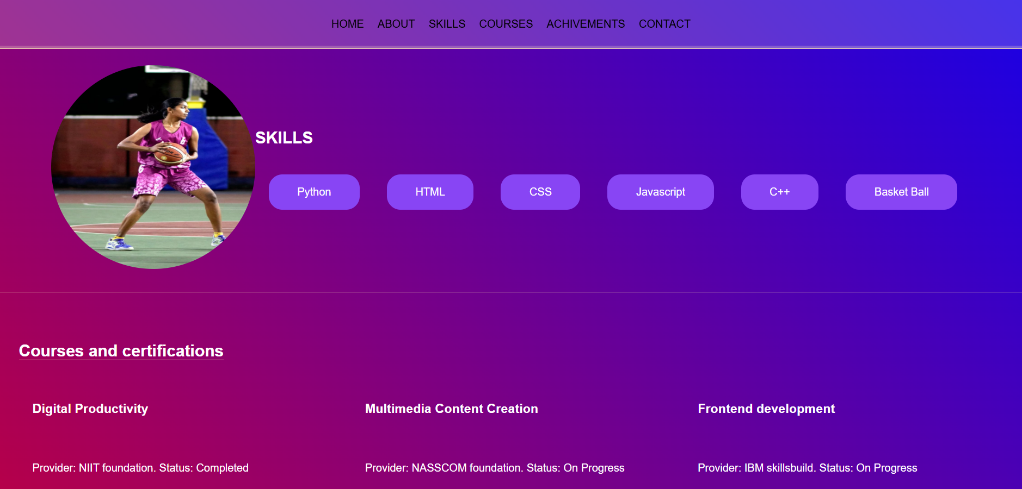
RESULTS AND SCREENSHOTS
3/21/2024 Annual Review
11

Slide 12
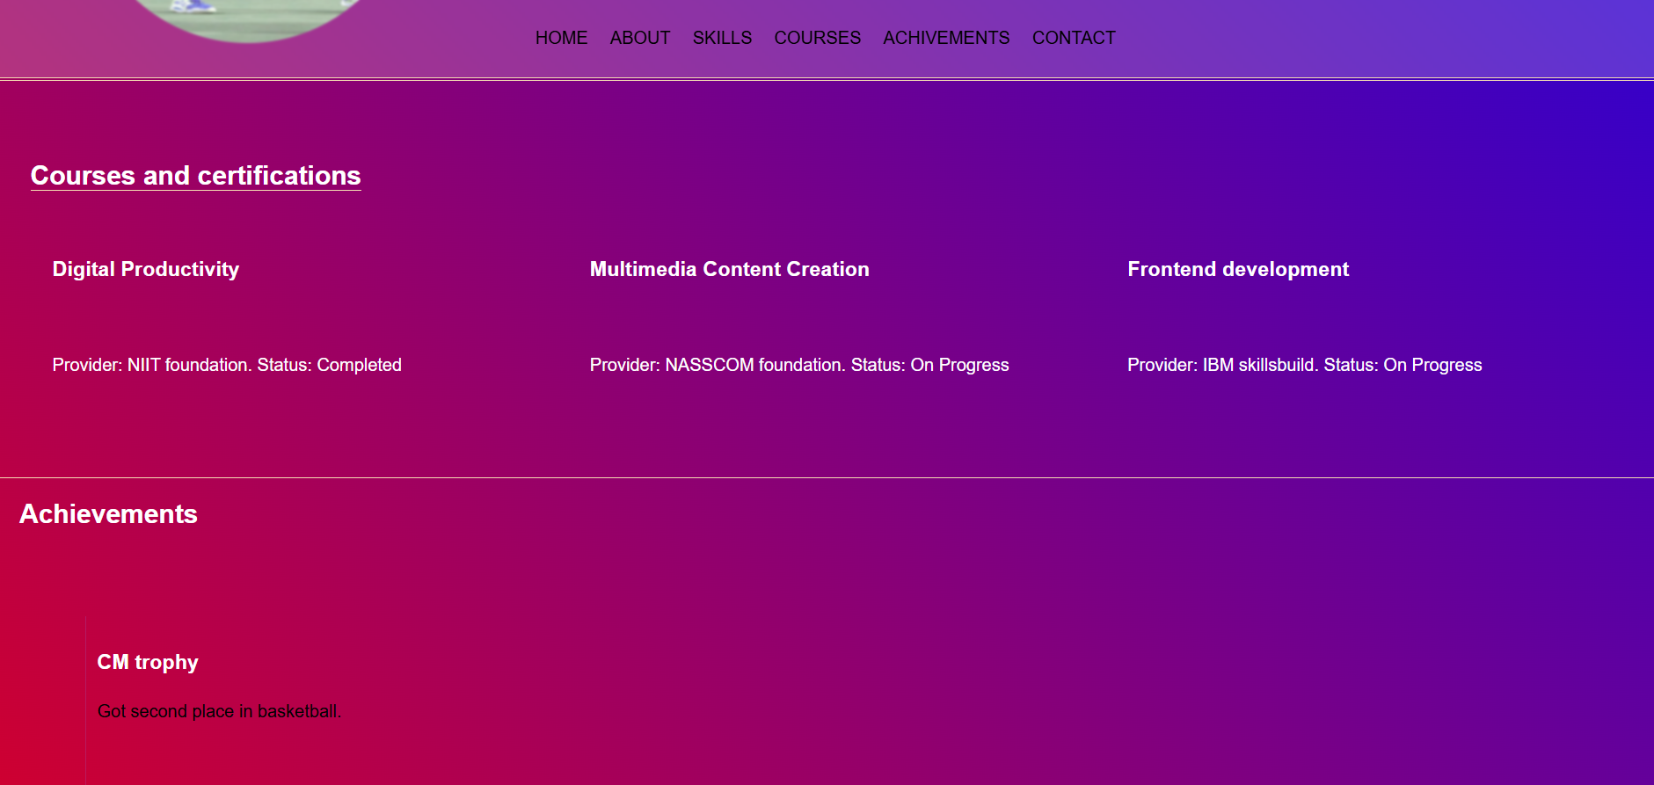
RESULTS AND SCREENSHOTS
3/21/2024 Annual Review
12

Slide 13
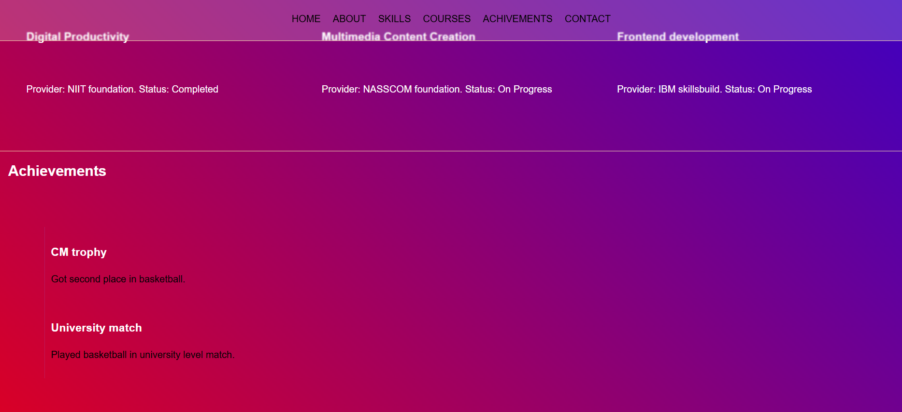
RESULTS AND SCREENSHOTS
3/21/2024 Annual Review
13

Slide 14
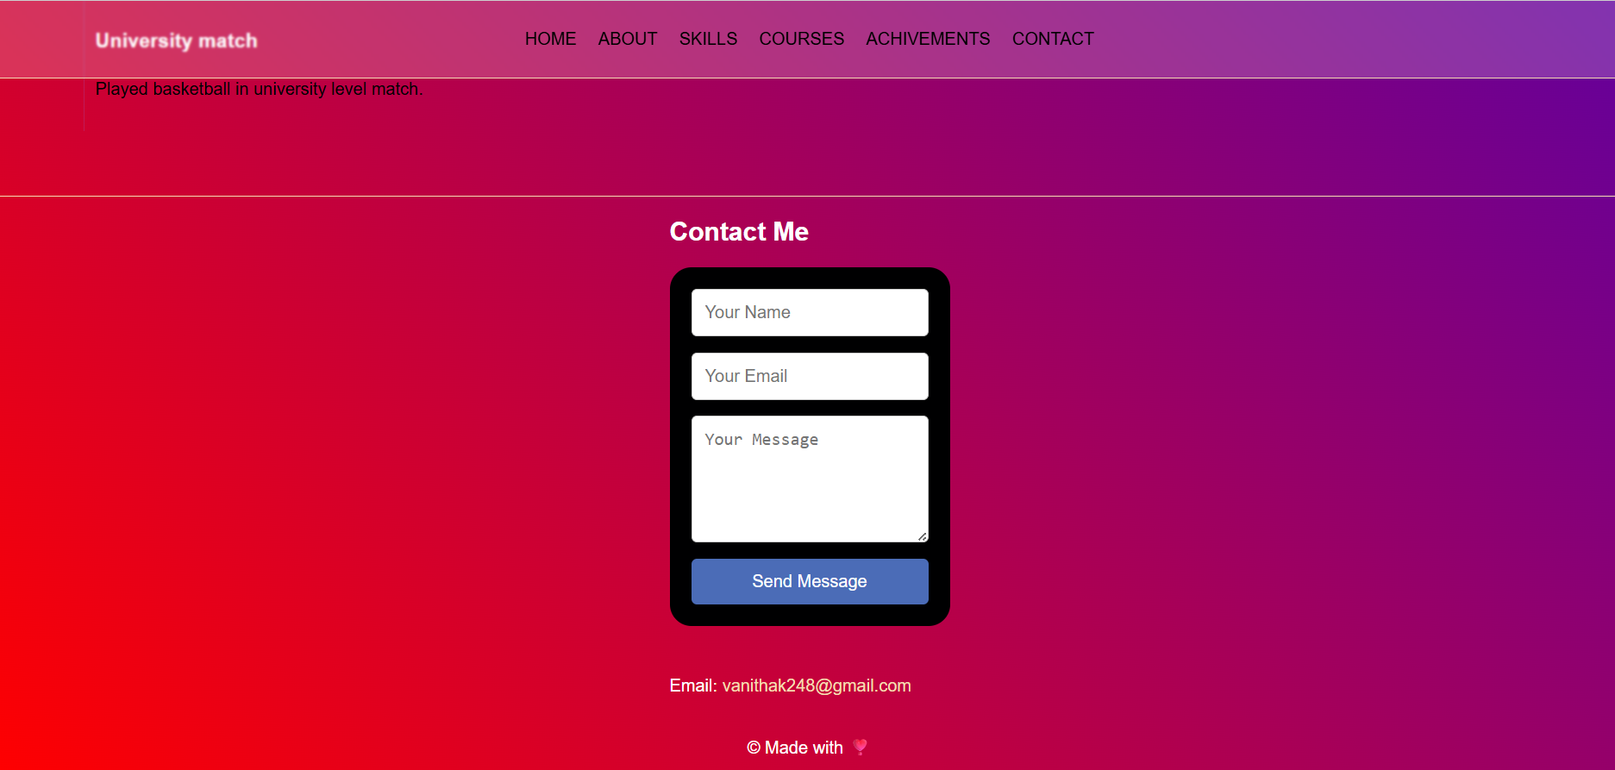
RESULTS AND SCREENSHOTS
3/21/2024 Annual Review
14

Slide 15
CONCLUSION
By embracing digital portfolios, students can dynamically showcase their projects ,skills, and progress, providing a more comprehensive and engaging representation of their abilities.
This approach not only highlights their technical expertise but also showcases their creativity and growth.
15

Slide 16
Github link
https://github.com/vanithak248-code/Vanitha-TNSDC-FWD-DP

